Slide 1
RUBEN’S
DECK ASSIGNMENT
FINAL INTERVIEW

Slide 2
GOODR5
PROMO
POP UP
BUILD//TEST//IMPLEMENT//RECOVERY
Notes:
WHITE TITLE SLIDE

Slide 3
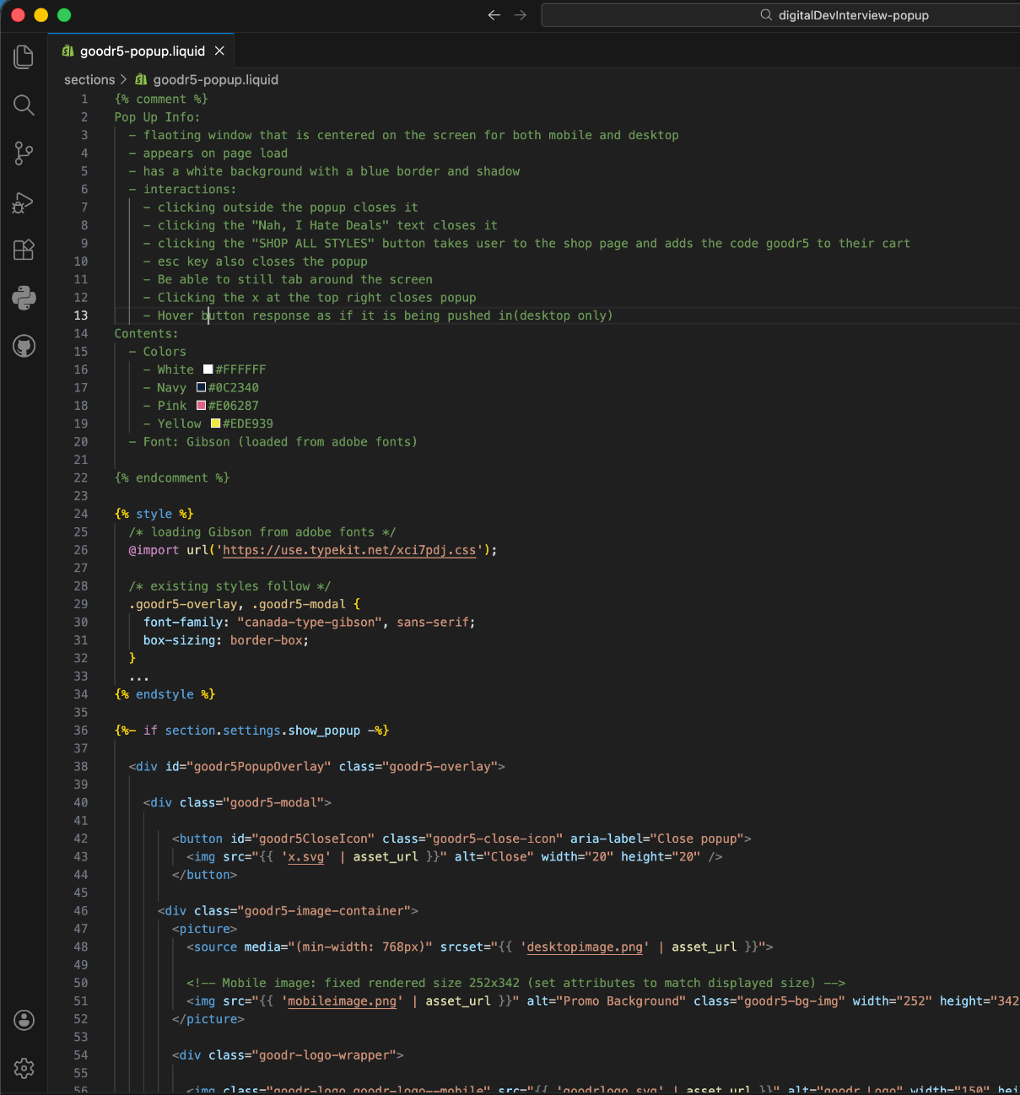
BUILD
Test Environment
https://boobenholes.myshopify.com
Password: saltyfeet
GitHub Repository https://github.com/boobenholes/DigitalDevPopUpAssignment.git
README: /README.md
Section Location: /sections/goodr5-popup.liquid
Deliverables
✅ Pop up(Modal) built as a Shopify section
/sections/goodr5-popup.liquid
✅ Triggers, Persisted Dismiss State
button, X, nah.., esc key, clicking off, session cookies
✅ Spec Accurate, Accessible, Responsive
goodr branding, mobile first approach, tabbing around, button response(desktop only)
✅ Prod Safe
built-in “enable” toggle, segmented classes
✅ Event Logging, Integration Stubs
trigger event logging(timestamps, button clicks, etc..), button automatically applies discount redirects to “all products”
Notes:
TITLE WITH TEXT AND ONE IMAGE

Slide 4
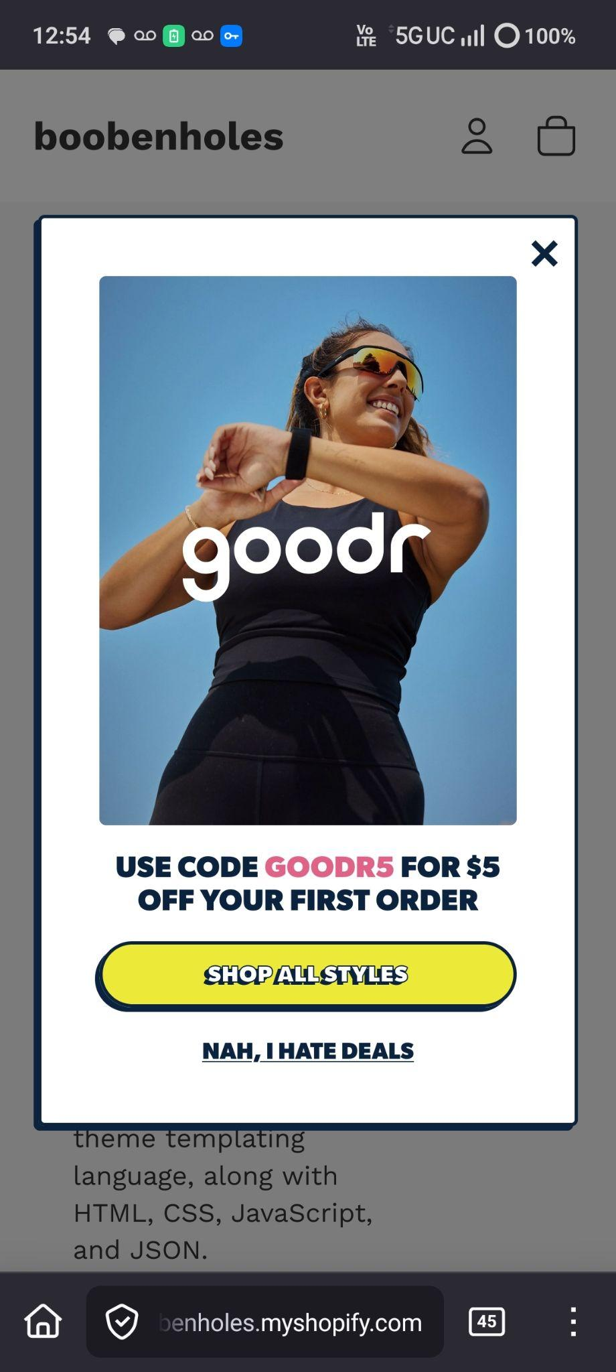
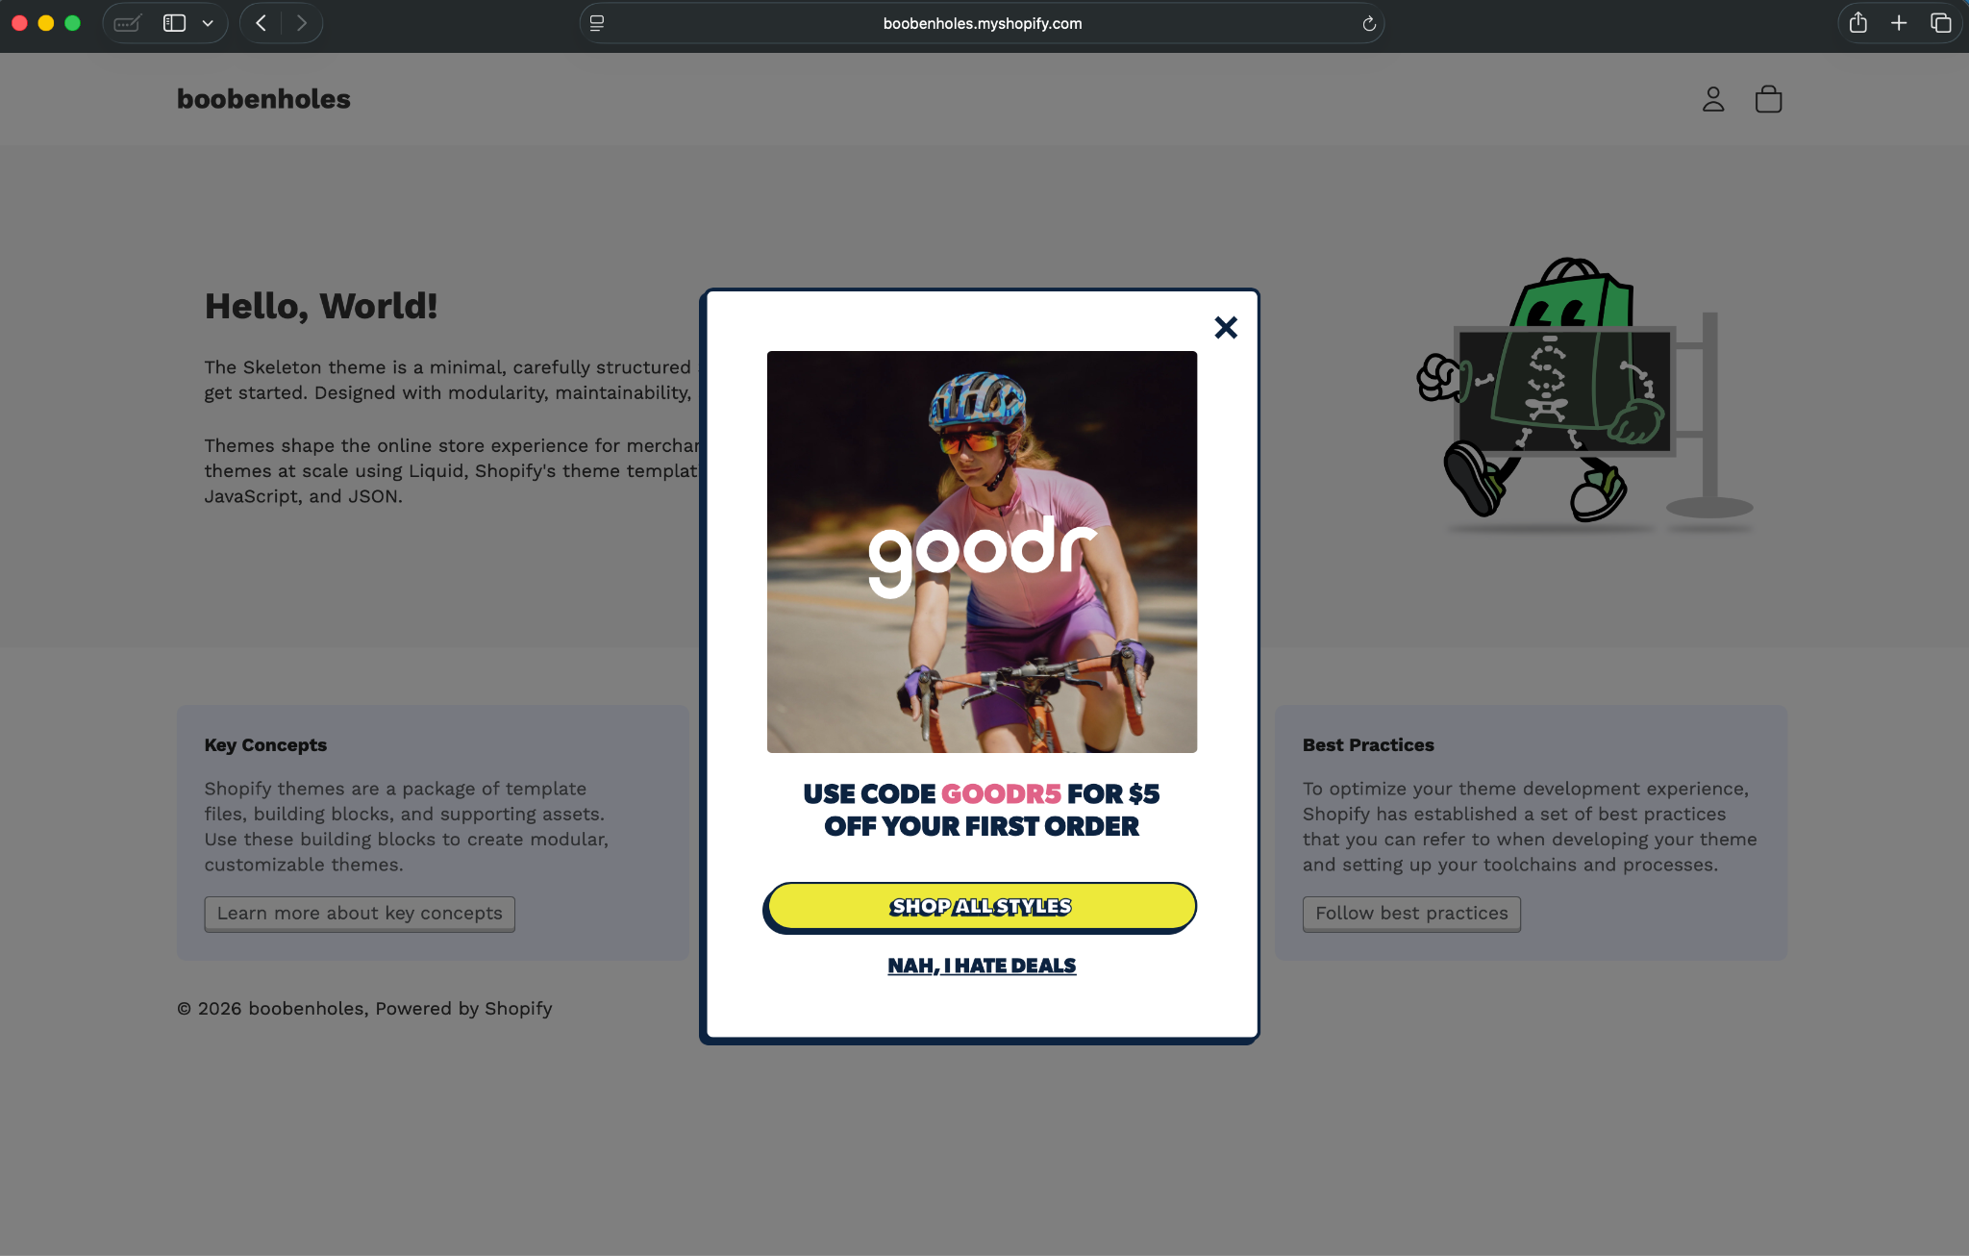
~ desktop//macOS//Safari
~ mobile//Android//Firefox
Notes:
TITLE WITH THREE IMAGES

Slide 5
RELEASE
PLAN
RELEASE//RECOVERY//COMMS
Duplicate live theme
easily revert to previous theme, if needed
Share with UX, Creative teams for sign off
screenshots & preview links
Utilize Pull Requests/Reviews
collaborating with Systems for quality control, logic reviews, integration dependencies
Shipping live code with pop up “off”
launch day, use toggle “off” feature
DR Procedures
low impact: toggle pop up “off” (launch day mis-queue, etc..)
high impact: revert back to previous theme (integration, layout, etc..)
Involve E-Comms Team for DR
develop and discus primary, alternate, contingent, & emergency comms(PACE List) & direct team to README for disaster recovery procedure review
TESTING//VALIDATION
Browsers: Google Chrome(desktop), Safari(macOS, iOS), Firefox(Android)
Layout
color validation, alignment, and functionality
Mobile Responsiveness
google chrome devtools, ensuring the pop up responds both on desktop and mobile
Accessibility
zoom, tab and esc keys usage and functionality
Safety Checks
ensure pop up is in disabled state when sent to production
Notes:
TITLE WITH LARGE TEXT BOX

Slide 6

FINAL
THOUGHTS
UX
goodr logo and fonts were tricky to get to spec. Referenced goodr.com using Chrome DevTools
Took some artistic freedom by leaving the gray overlay behind the pop up box
Working with relative units(percentages) rather than absolute units(pixels) will achieve better responsiveness regarding different screen resolutions.
OVERALL
UX and deck instructions were clear and concise
Had a lot of fun on this!
Thank you!
Notes:
TITLE WITH LARGE TEXT BOX

Slide 7
QUESTIONS?
Notes:
TITLE WITH LARGE TEXT BOX

Slide 8
TASK ONE

Slide 9

TASK
ONE
YOUR MISSION: BUILD A POP-UP TO SPEC (FIGMA → SHOPIFY)
BRIEF: The team wants a standard goodr pop-up for goodr.com built to spec. HERE is a Figma file with annotations and dev notes to guide you.
PLEASE FOLLOW THESE STEPS:
Build a Shopify theme component: Create a reusable theme component (section/snippet) that could realistically be used. You do not need access to a live Shopify environment to complete this task.
Implement required pop-up functionality:
  Display logic (configurable trigger; persisted dismiss state)
  UX behavior (spec-accurate; accessible; responsive)
  Implementation quality (no CLS; scoped CSS/JS; prod-safe)
  Integration stub (email validation; event logging; show where a real integration would live
DELIVERABLES (Please submit your build/file in a GitHub repository):
Working build: Realistic code that could be dropped into a Shopify theme
README file (1 page max): how to install/enable the pop-up, key assumptions/tradeoffs, what you’d improve with more time.
Be prepared to demo: Walk us through your code, decisions, and behavior!
Notes:
TITLE WITH TEXT AND ONE IMAGE

Slide 10
TASK TWO

Slide 11
TASK
TWO
YOUR MISSION: BUILD A SAFE RELEASE & COLLABORATION PLAN
BRIEF: This pop-up needs to ship ahead of a launch.
You are the first developer fully embedded in the E-Commerce team, partnering closely with Creative and a centralized Systems/Engineering team with some other developers (front-end and back-end).
PLEASE FOLLOW THESE STEPS:
Create a deployment + safety plan that covers:
  Testing & validation
  Release strategy
  Rollback plan (disable/revert if something breaks)
  Communication & documentation (what you share, with what teams, and how detailed)
Include how you’d use version control (branching. PR, reviews)
DELIVERABLE (Please submit in the same GitHub repository as Task One):
Short written plan (3-5 slides): Outline how you would test, release, and communicate this change.
Notes:
TITLE WITH TEXT AND ONE IMAGE

